Slide 1

USING MACHINE LEARNING FOR IMAGE TRAINING AND INDEXING
Team member 1 (Katelyn Allen, kallen52@kent.edu)
Team member 2 (Travis Cottrell, tcottre4@kent.edu)
Team member 3 (Austin Brooks, abrook25@kent.edu)
Team member 4 (Eman Khan, ekhan2@kent.edu)

Slide 2
Motivation
Categorizing images is an extremely time consuming job. With machine learning this job can be done quickly and automatically. Using machine learning we are able to train our algorithm to have the best possible outcome of data loss and accuracy.

Slide 3
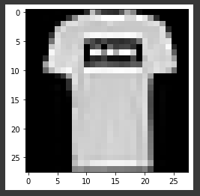
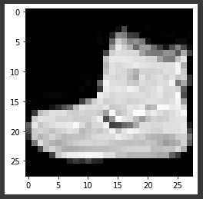
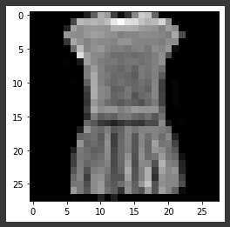
Project Description
Our goal is to:
Implement an efficient way to index images with machine learning
Sort images of articles of clothing into separate categories
Improve existing algorithms capabilities by training with an image dataset

Slide 4


Software Tools
Tensorflow
60,000 grayscale images of different clothing articles
Google Collaborate
Contributed ease of use and accessibility for our group

Slide 5

Hardware Tools
Hardware used
Google Cloud server
Hardware for larger datasets
Powerful GPU for faster image processing
CPU
RAM

Slide 6




Libraries
Python libraries
NumPy
math functions
Matplotlib
plot graphs
Scikit-learn
efficient tools for machine learning

Slide 7
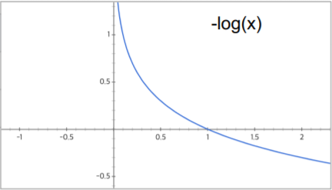
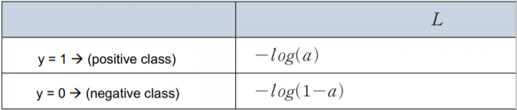
Formal Mathematical Definition
Overall, we are trying to reduce loss while maintaining a high level of accuracy for our model.
The formal mathematical definition of logistic loss is as follows:

Slide 8
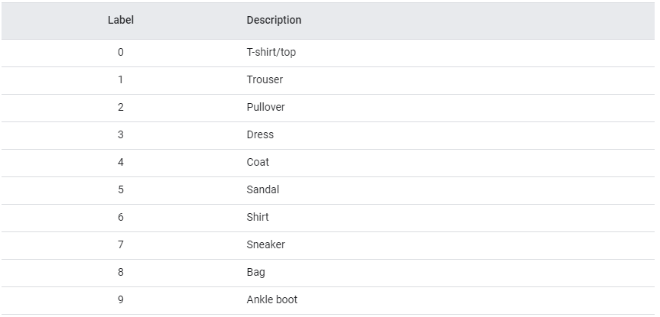
Multi-Classification Network
What is a Multi-Classification Network?
It is a classification network that allows for a program to pick between three or more classifications instead of just two.
Ours allows for the program to select between ten different classifications.

Slide 9
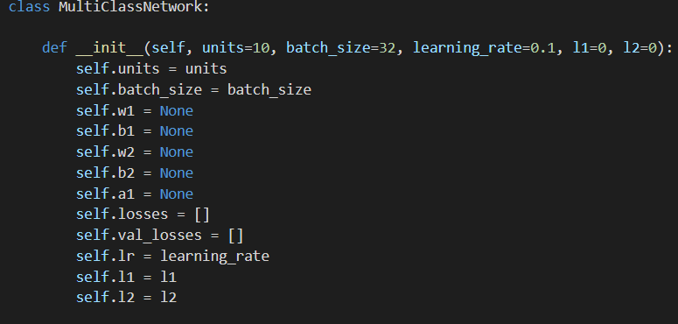
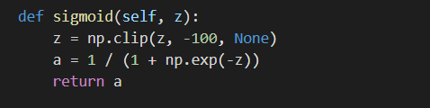
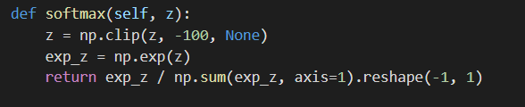
Multi-Classification Network

Slide 10
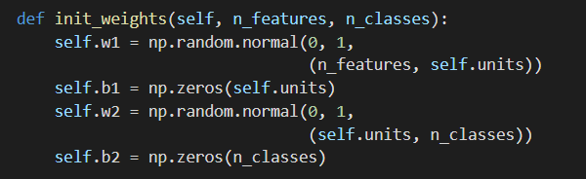
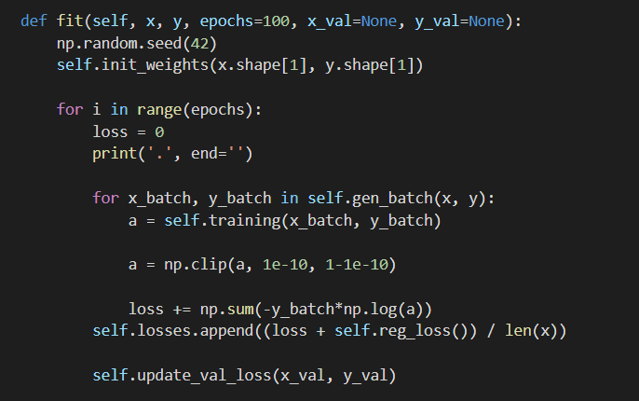
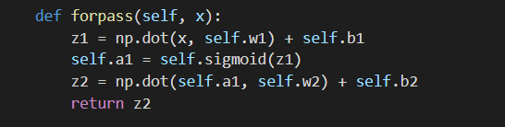
Multi-Classification Network

Slide 11
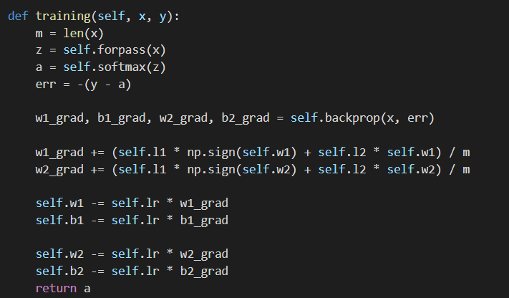
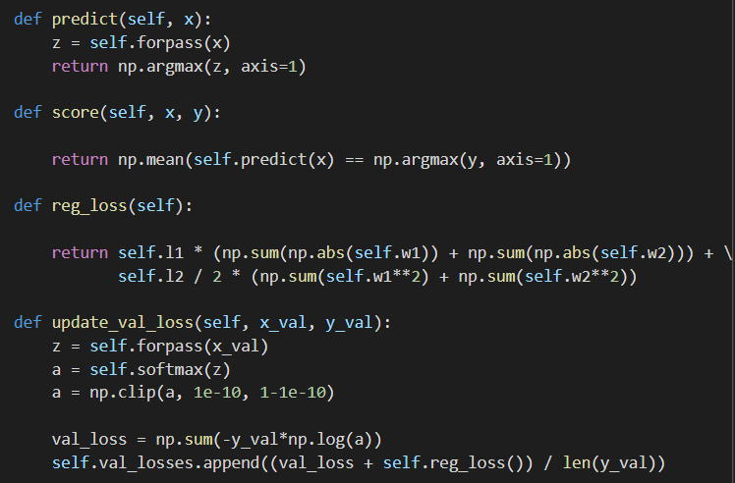
Multi-Classification Network

Slide 12

Experimental Evaluation (30 Epochs)
We started by training our Multi Class Network model at 30 Epochs
By tuning our parameters and our Epochs, we were able to record the following during the first round of training:
Training Set Accuracy : 85.51%
Training Set Loss : 0.4110
Validation Set Accuracy : 85.68%
Validation Set Loss : 0.4049
Overall Accuracy of our Model : 85.68%

Slide 13
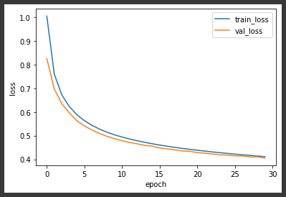
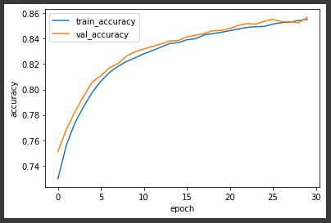
Experimental Evaluation (30 Epochs)
Here we analyze our Validation and Training set losses to report the optimization of our model
We can see a small gap in our losses, meaning that our model is not yet optimized and is referred to as under-fit.
Loss Graph
Accuracy Graph

Slide 14

Experimental Evaluation (50 Epochs)
Next we trained our Multi Class Network model at 50 Epochs
By tuning our parameters and our Epochs, we were able to record the following during this round of training:
Training Set Accuracy : 86.61%
Training Set Loss : 0.3717
Validation Set Accuracy : 86.60%
Validation Set Loss : 0.3782
Overall Accuracy of our Model : 86.60%

Slide 15
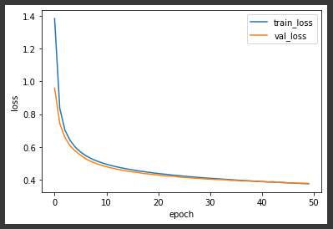
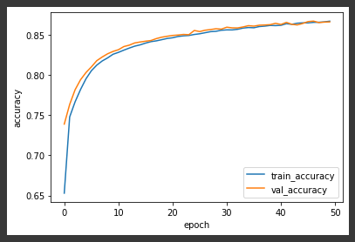
Experimental Evaluation (50 Epochs)
Here we analyze our Validation and Training set losses to report the optimization of our model
We can see the validation and training set losses have met and begin to shift apart, meaning that our model is again not yet optimized and is now referred to as over-fit.
However, we can now see in our graph that the optimal Epochs seems to be around 40.
Loss Graph
Accuracy Graph

Slide 16

Experimental Evaluation (40 Epochs)
Finally we trained our Multi Class Network model at 40 Epochs
By tuning our parameters and our Epochs, we were able to record the following during this round of training:
Training Set Accuracy : 86.40%
Training Set Loss : 0.3889
Validation Set Accuracy : 85.94%
Validation Set Loss : 0.3914
Overall Accuracy of our Model : 85.94%

Slide 17
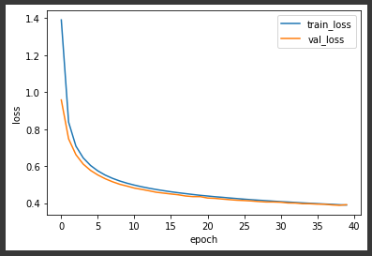
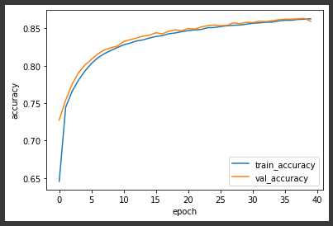
Experimental Evaluation (40 Epochs)
Here we analyze our Validation and Training set losses to report the optimization of our model
We can see the validation and training set losses are as closer together than at any other amount of Epochs, and so for our 60,000 clothing image dataset, this is our best fit model.
Loss Graph
Accuracy Graph

Slide 18
Conclusion
The window at which training and validation loss is at its most efficient is 40 Epochs. Any more or less and we start to see our logistic loss become unstable and in most cases rise, producing a reduction in the program’s indexing capabilities.

Slide 19
Future Work
Scale our Multi Class Network Model for larger image datasets.
May result in better training and validation accuracy
Attempting to train the model for much larger datasets (i.e millions of images) would require large amount GPU processing power.

Slide 20
References
B. Kieffer, M. Babaie, S. Kalra and H. R. Tizhoosh, "Convolutional neural networks for histopathology image classification: Training vs. Using pre-trained networks," 2017 Seventh International Conference on Image Processing Theory, Tools and Applications (IPTA), Montreal, QC, Canada, 2017, pp. 1-6, doi: 10.1109/IPTA.2017.8310149.
https://ieeexplore.ieee.org/document/8310149?denied=
D. A. Abd Al lattif and M. M. Hamad, "A Comparative Study of Indexing Techniques Effect in Big Data System Storage Optimization," 2020 2nd Al-Noor International Conference for Science and Technology (NICST), Baku, Azerbaijan, 2020, pp. 18-21, doi: 10.1109/NICST50904.2020.9280309.
https://ieeexplore-ieee-org.proxy.library.kent.edu/document/9280309?arnumber=9280309
Ezat, Wael & Dessouky, Mohamed & Ismail, Nabil. (2020). Multi-class Image Classification Using Deep Learning Algorithm. Journal of Physics: Conference Series. 1447. 012021. 10.1088/1742-6596/1447/1/012021.
https://iopscience.iop.org/article/10.1088/1742-6596/1447/1/012021

